Slide 1
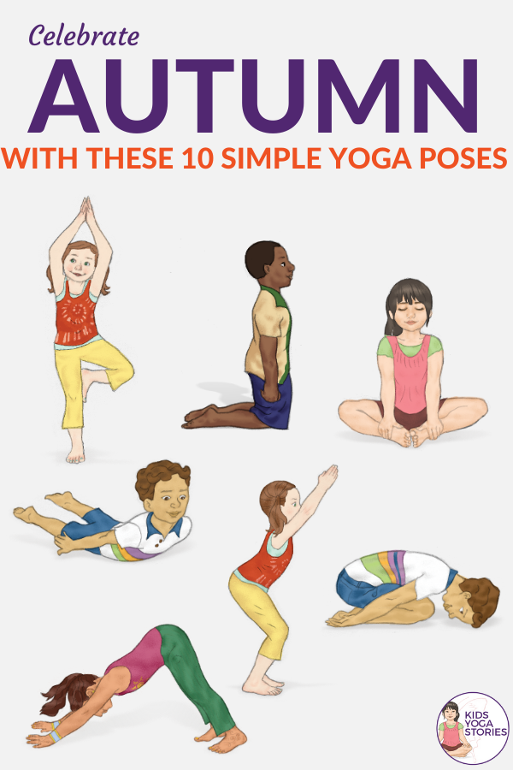


Welcome to STEM!
While you wait, please do the following…
Pin the screen I am sharing to make it big.
Make sure you are muted.
Use the bathroom if you need to!
Stand up and stretch your arms and your legs. Try these stretches!
Close your eyes and take 5 slow deep breaths - in through your nose and out through your mouth.
Think of 2 things that have made you smile this week.

Slide 2
Robotics
and
Coding
Today we will…
Learn about robots and how robots are created.
This is important because…
Robots technology is growing and changing the way our world runs.
We will be successful when…
We can define what a robot is and give some examples of robots we have seen.
Itinerary:
-Draw your own robot
-Learn what makes a robot
-See some robots from our own lives
-Vocabulary: Algorithm
-Challenge: Double Delivery Programing Game

Slide 3
Draw a Robot
What do you think a robot is?
You have 4 minutes to draw a robot on Padlet
My Robot Padlet Link
Does your robot do a job or a task?
How does your robot have energy?
Can your robot to more than one task?

Slide 4
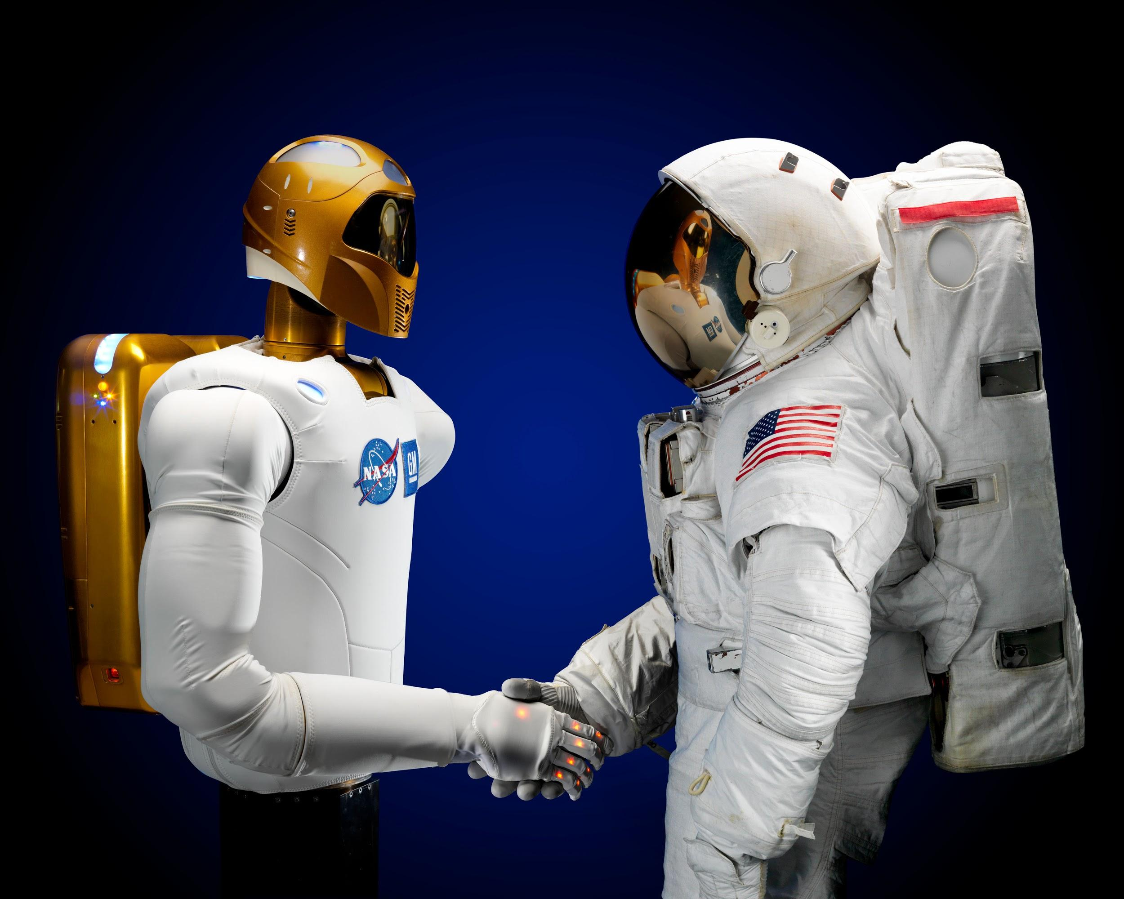
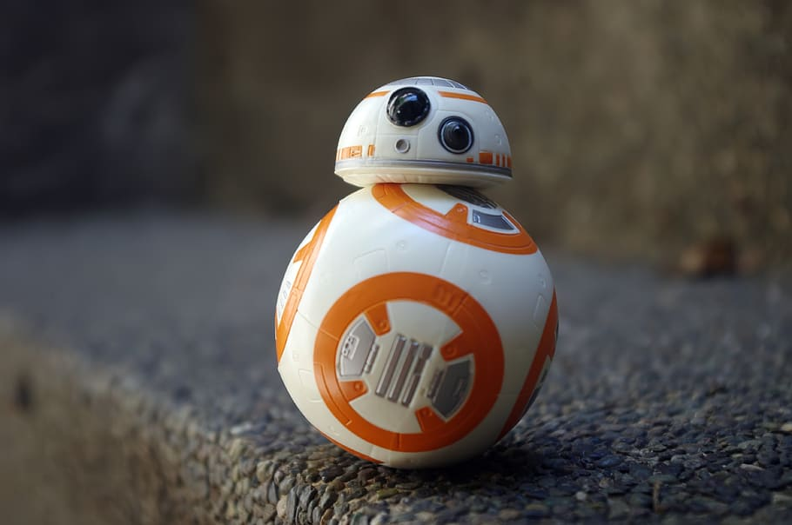
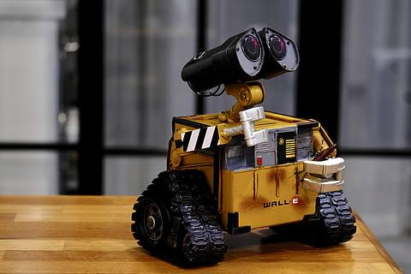
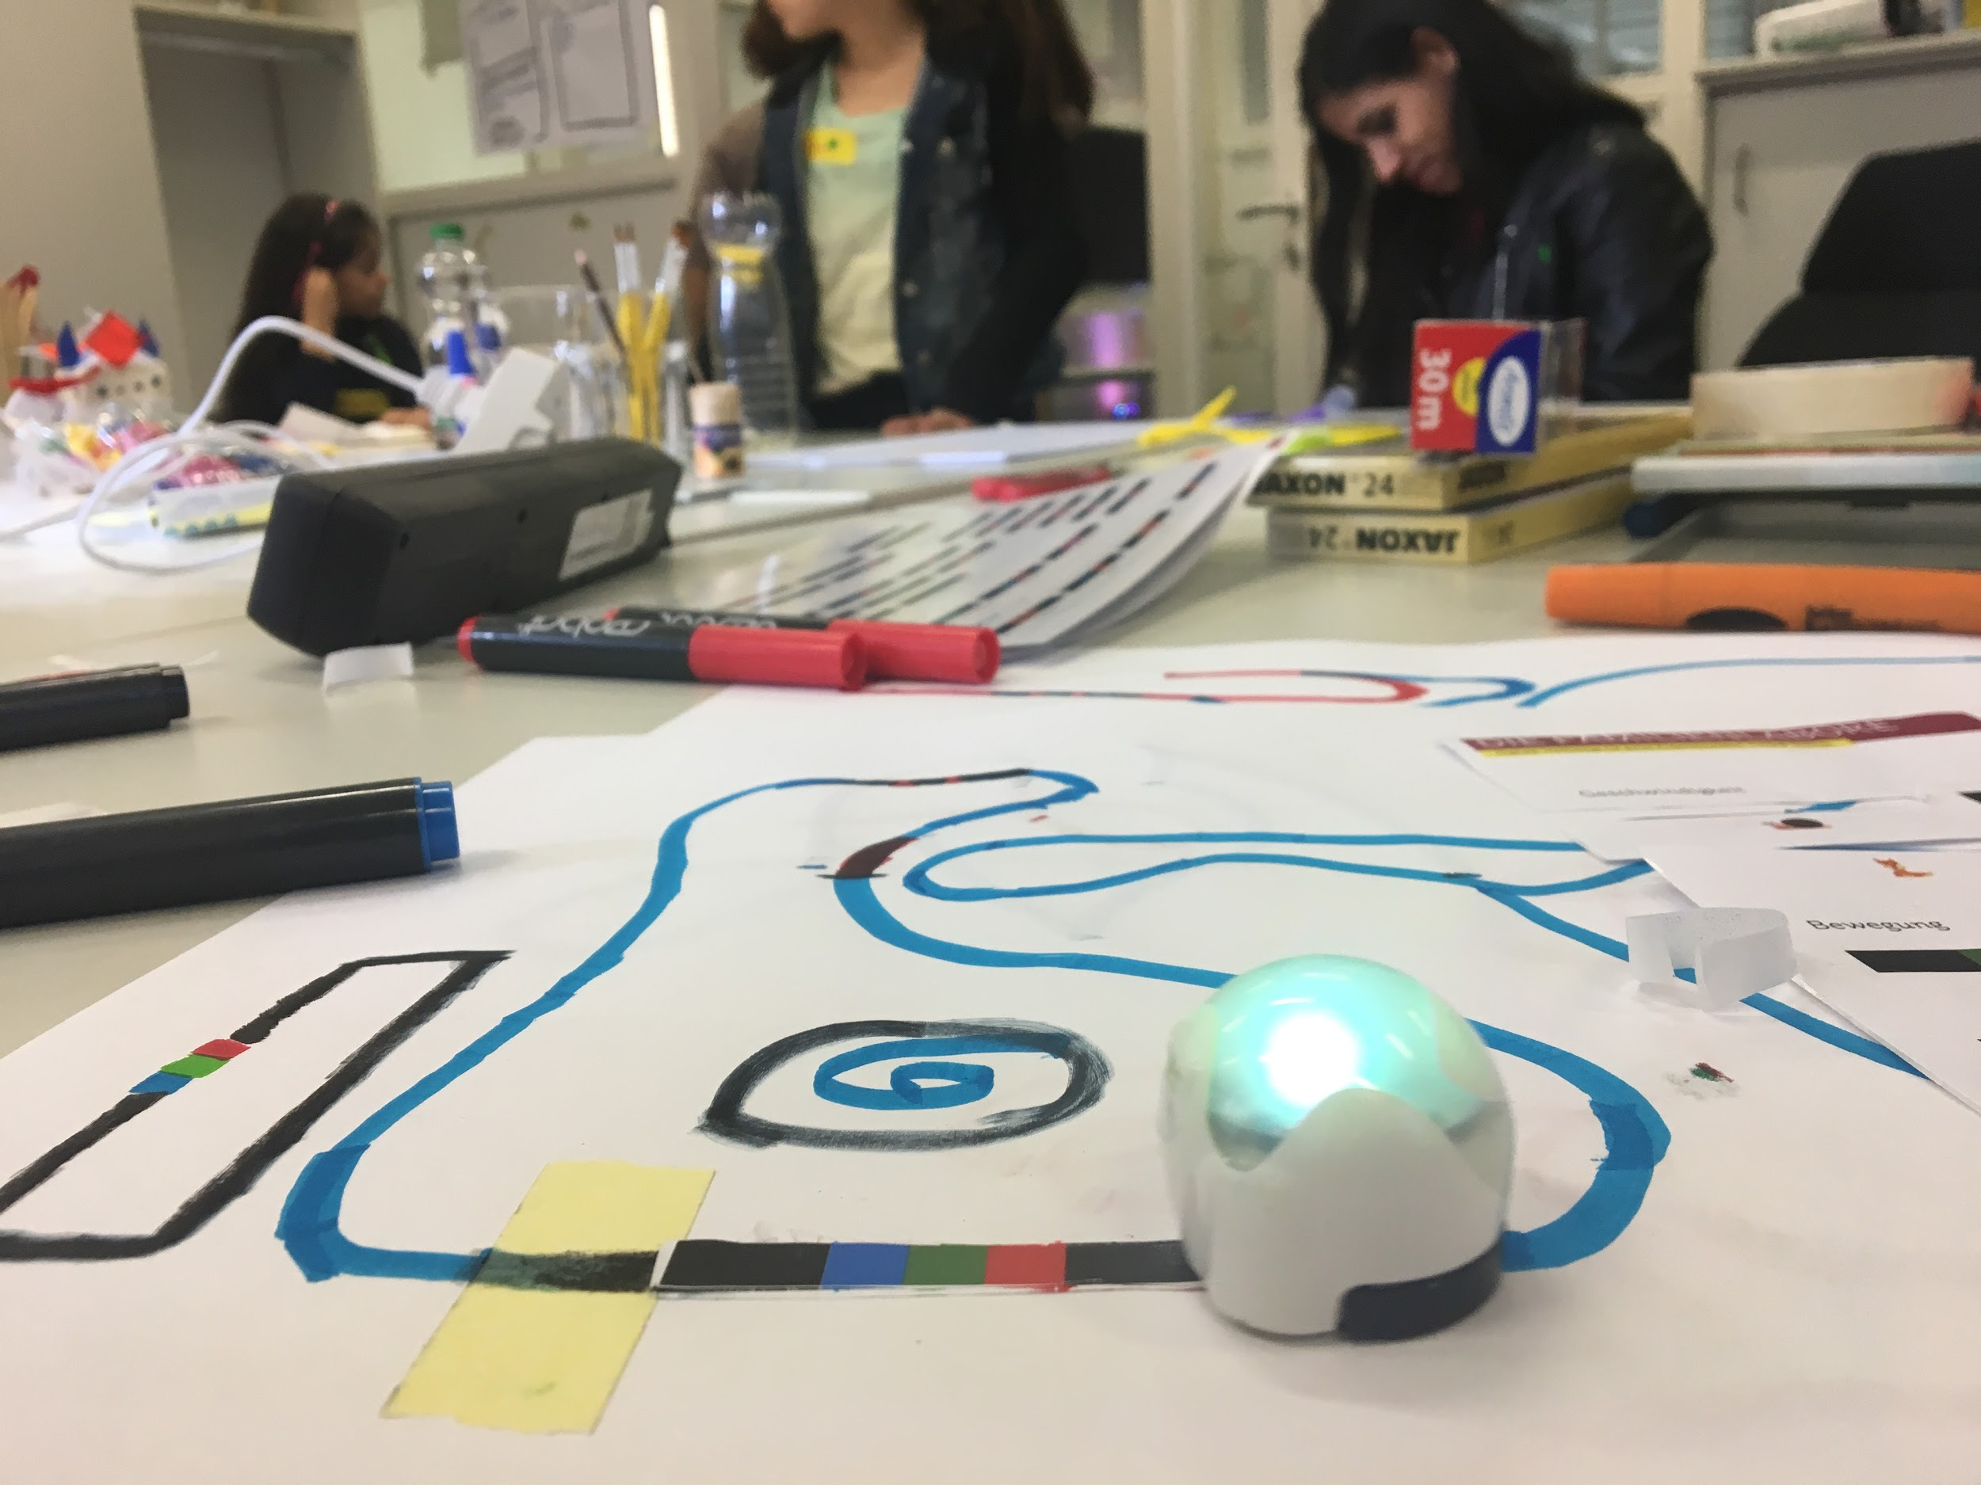
What makes a Robot?
There are some key things that make a robot a robot.
-A machine which helps humans with hard tasks
-Explore Space
-Clean up in harsh climates
-Entertain

Slide 5
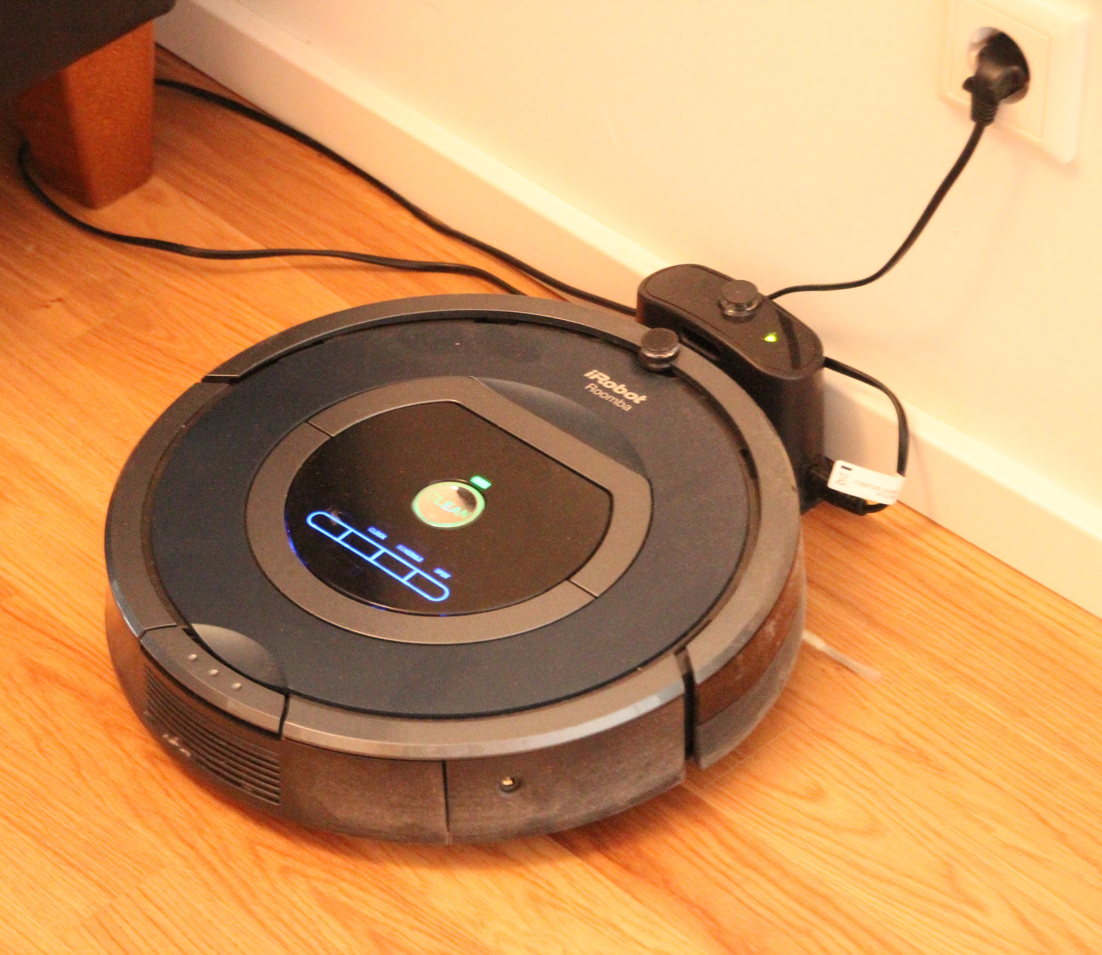
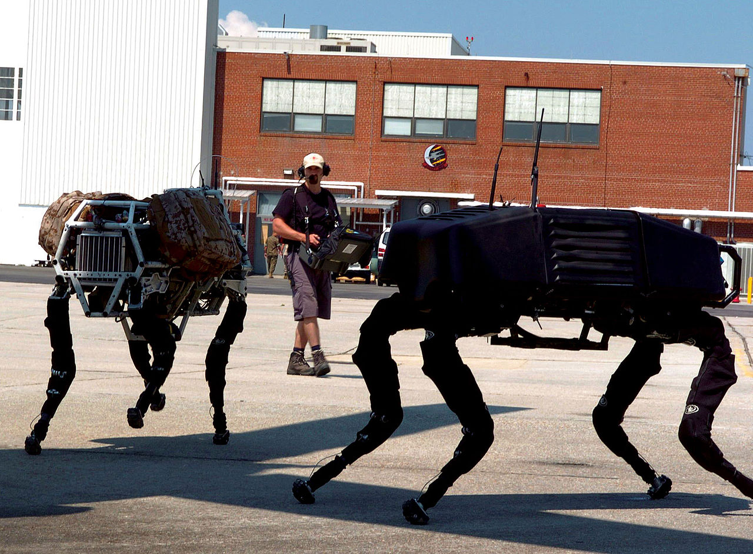
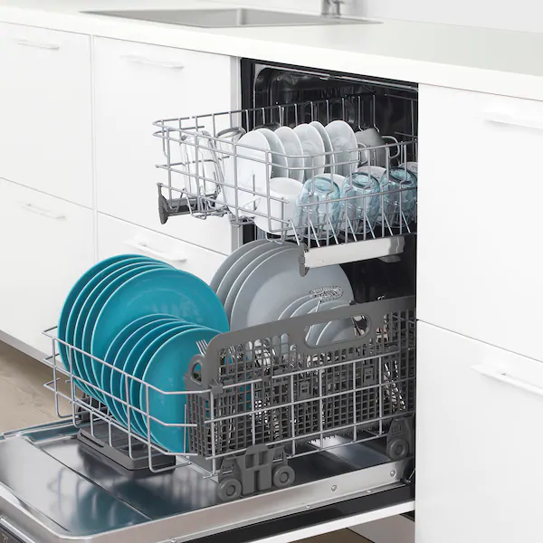
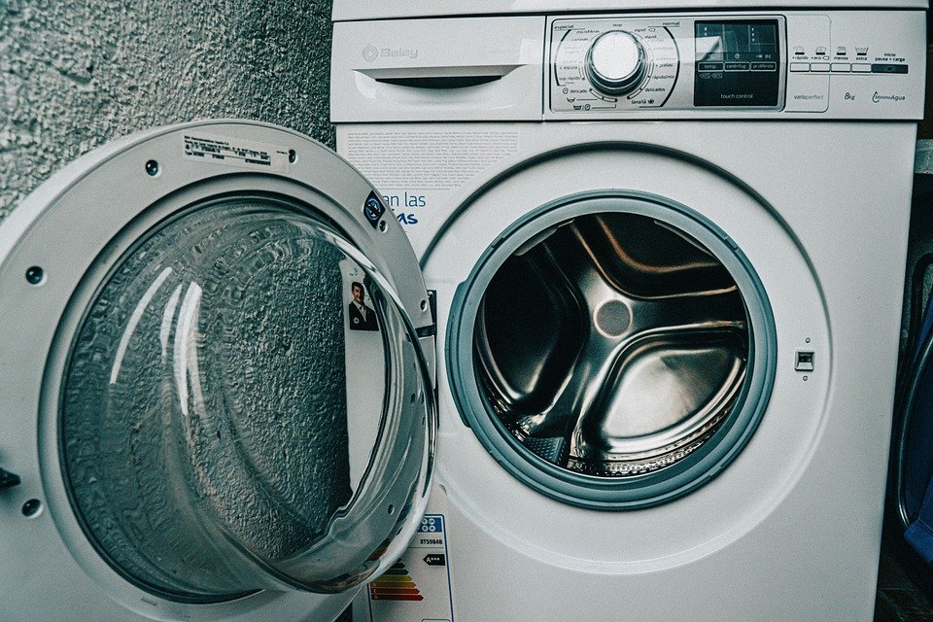

Robots in our Lives
Have you seen any of these robots?
-Dishwasher
-Vacuum Cleaner
-Washing Machine
-Drones
-Robot Dogs

Slide 6
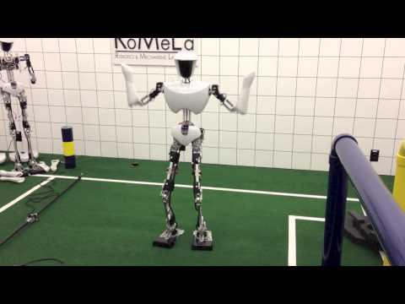




Robots---Virginia Tech

Slide 7

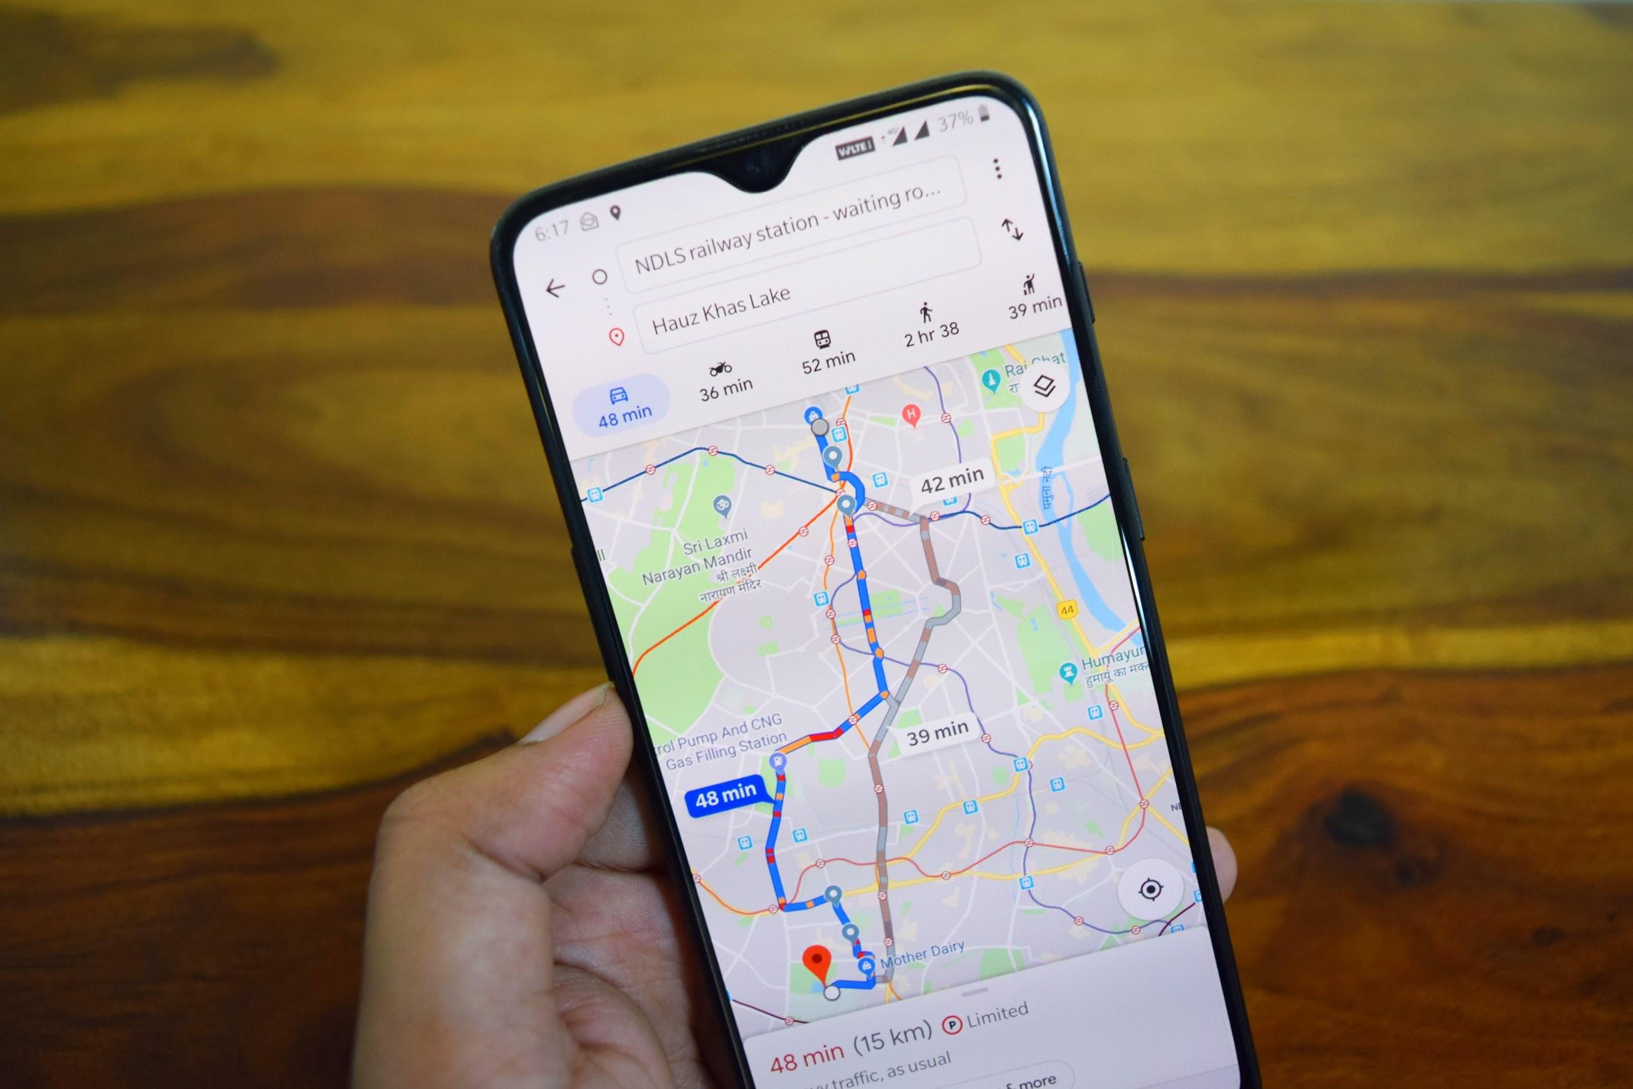
An Algorithm is...
A set of instructions a machine can understand.
-Example: Google
Maps
Walk 10 Steps
Turn Left
Walk 10 Steps

Slide 8
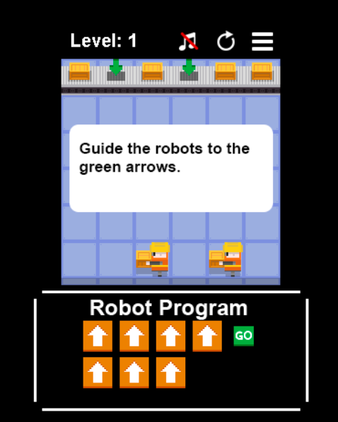
Double Delivery
Challenge yourself - Can you program these robots to complete their delivery?
How many levels can you beat???
Remember, a robot only knows what we tell it! A robot can only follow the algorithms it has been given.

